Slide 1
Dwarf Galaxy Stability in MilkyWay@home
Spring 2024 Jason Kim
Notes:
started investigating sidm code
Is it stable?

Slide 2
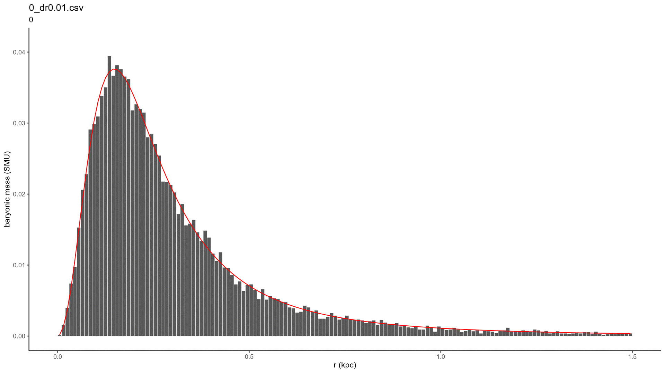
Notes:
no
explanation of graph axes, title/subtitle

Slide 3
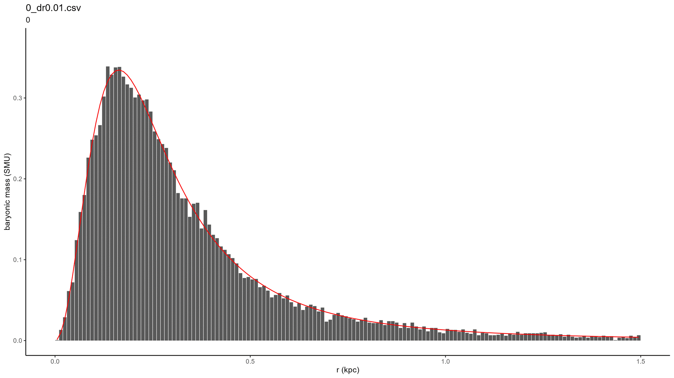
Issues with SIDM
Eric’s vs Sid’s galaxy
Inconsistent behavior
Eric’s: very late equilibrium / loss of almost all structure
Sid’s: late equilibrium / large loss of structure
Notes:
explanation of parameter differences
- eric: orphan-chenab stream
- sid: own study on dwarf galaxy generation and stability
Inconsistent behavior
- partial collapse

Slide 4


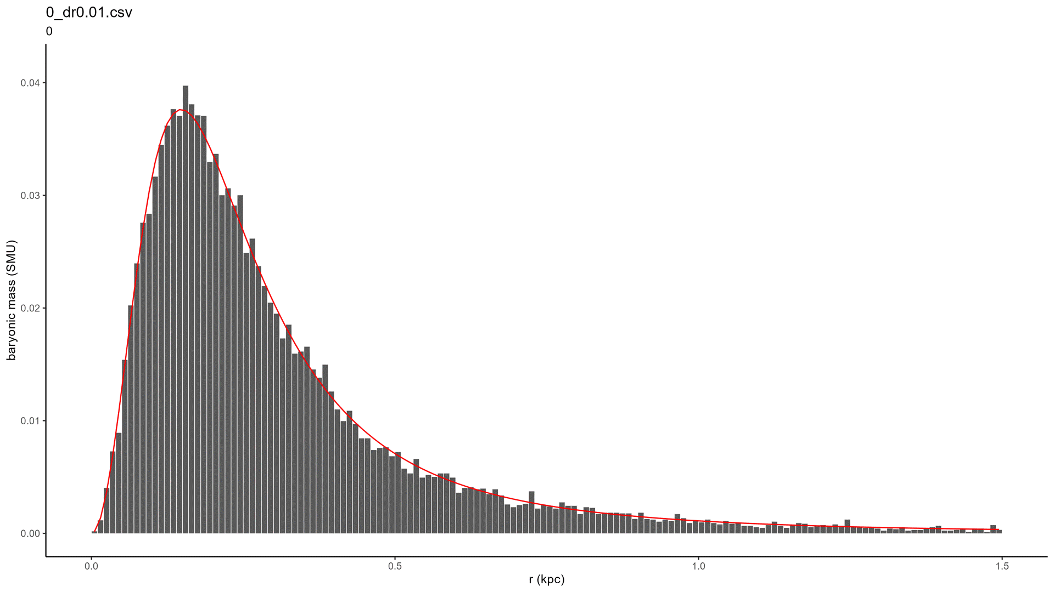

Other Profiles
More stable, but not completely
Indicates something wrong with SIDM
Plummer + Plummer
Plummer + NFW
Sid’s
Eric’s
Notes:
More datapoints

Slide 5
Previous Version
v1.80 (2021)
Similar behavior / no change
No change in nbody_mixeddwarf.c
Where galaxy generation is handled
This “error” existed from all the way back in 2021 and possibly even before
Plummer + Plummer
Plummer + NFW
Sid’s
Eric’s

Slide 6
Summary
test | version | branch | params | components | initial | t_{stable} | final
202404132100 | current (Feb 2024) | master | Sid | plummer+plummer | ✓ | 0.5-1.0 Gy | ✓
202404141050 | v1.80 (May 2021) | master | Sid | plummer+plummer | ✓ | 0.5-1.0 Gy | ✓
202404132220 | current (Feb 2024) | master | Sid | plummer+nfw | ✓ | 0.5-1.0 Gy | ✓
202404141025 | v1.80 (May 2021) | master | Sid | plummer+nfw | ✓ | 0.5-1.0 Gy | ✓
202404021330 | current (Feb 2024) | master | Eric | plummer+plummer | ✓ | 2.5-3.0 Gy | ?
202404082220 | v1.80 (May 2021) | master | Eric | plummer+plummer | ✓ | 2.5-3.0 Gy | ?
202404021450 | current (Feb 2024) | master | Eric | plummer+nfw | ✓ | 2.5-3.0 Gy | ?
202404082325 | v1.80 (May 2021) | master | Eric | plummer+nfw | ✓ | 2.5-3.0 Gy | ?
202404131940 | current (Jan 2024) | sidm | Sid | plummer+sidm | ✓ | 1.5-2.0 Gy | ?
202404072115 | current (Jan 2024) | sidm | Eric | plummer+sidm | ✓ | 3.0-3.5 Gy | ✗
Notes:
Explanation of table and t_{stable}

Slide 7
Instability and Equilibrium
Initial instability is intended
Imperfect parameters
Additional: reach equilibrium within a reasonable amount of time
e.g. max 1 GY
“After 4 Gyr of evolution, there is a significant shift in the radial profile. This is due to relaxation of the bodies in the structure, reaching an equilibrium state. As we will show … the dwarf galaxy is created very close to equilibrium. As the dwarf galaxy evolves in empty space, the virial ratio approaches one.” ¹
Notes:
Sid’s quote
- additional conditional

Slide 8
Summary
test | version | branch | params | components | initial | t_{stable} | final
202404132100 | current (Feb 2024) | master | Sid | plummer+plummer | ✓ | 0.5-1.0 Gy | ✓
202404141050 | v1.80 (May 2021) | master | Sid | plummer+plummer | ✓ | 0.5-1.0 Gy | ✓
202404132220 | current (Feb 2024) | master | Sid | plummer+nfw | ✓ | 0.5-1.0 Gy | ✓
202404141025 | v1.80 (May 2021) | master | Sid | plummer+nfw | ✓ | 0.5-1.0 Gy | ✓
202404021330 | current (Feb 2024) | master | Eric | plummer+plummer | ✓ | 2.5-3.0 Gy | ?
202404082220 | v1.80 (May 2021) | master | Eric | plummer+plummer | ✓ | 2.5-3.0 Gy | ?
202404021450 | current (Feb 2024) | master | Eric | plummer+nfw | ✓ | 2.5-3.0 Gy | ?
202404082325 | v1.80 (May 2021) | master | Eric | plummer+nfw | ✓ | 2.5-3.0 Gy | ?
202404131940 | current (Jan 2024) | sidm | Sid | plummer+sidm | ✓ | 1.5-2.0 Gy | ?
202404072115 | current (Jan 2024) | sidm | Eric | plummer+sidm | ✓ | 3.0-3.5 Gy | ✗
Notes:
T_stable

Slide 9
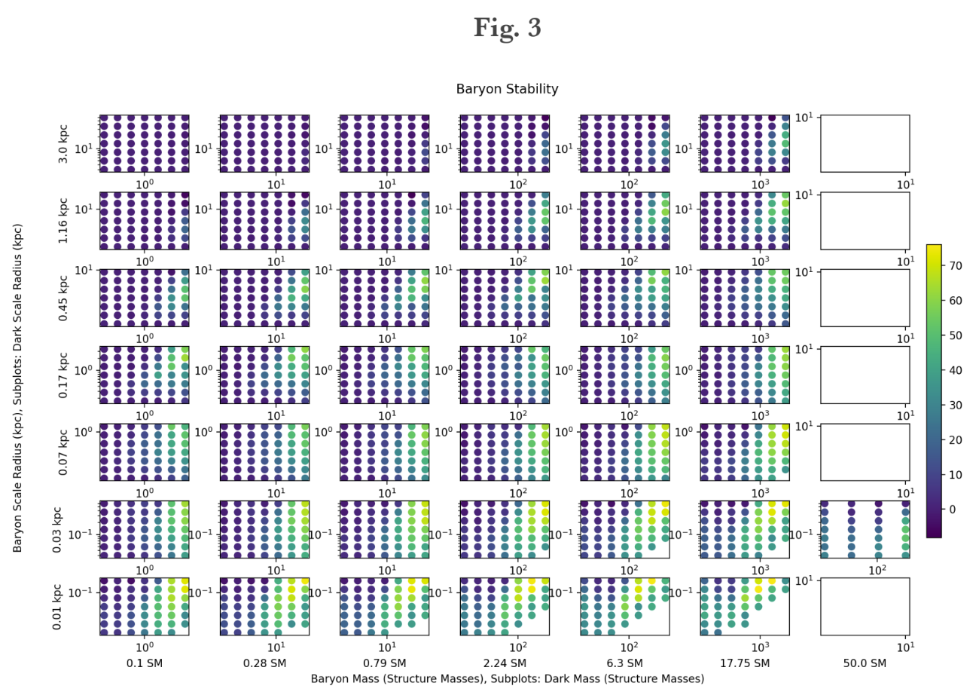
Parameter Selection
Previous report investigating galaxy stability ²
Useful chart ->
Eric’s params (red): stability score of 30-40
m_{l} = 1.22 SM r_{s,l} = 0.181 kpc
m_{d} = 95.7 SM r_{s,d} = 0.810 kpc
Sid’s params (blue): stability score of ~0
m_{l} = 12.0 SM r_{s,l} = 0.2 kpc
m_{d} = 48.0 SM r_{s,d} = 0.8 kpc
Notes:
Higher is bad

Slide 11
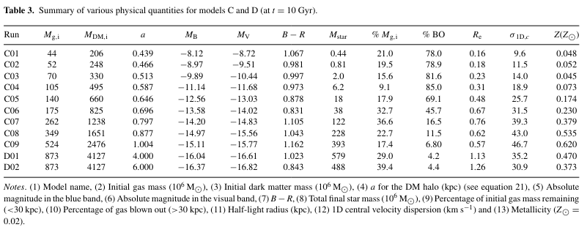
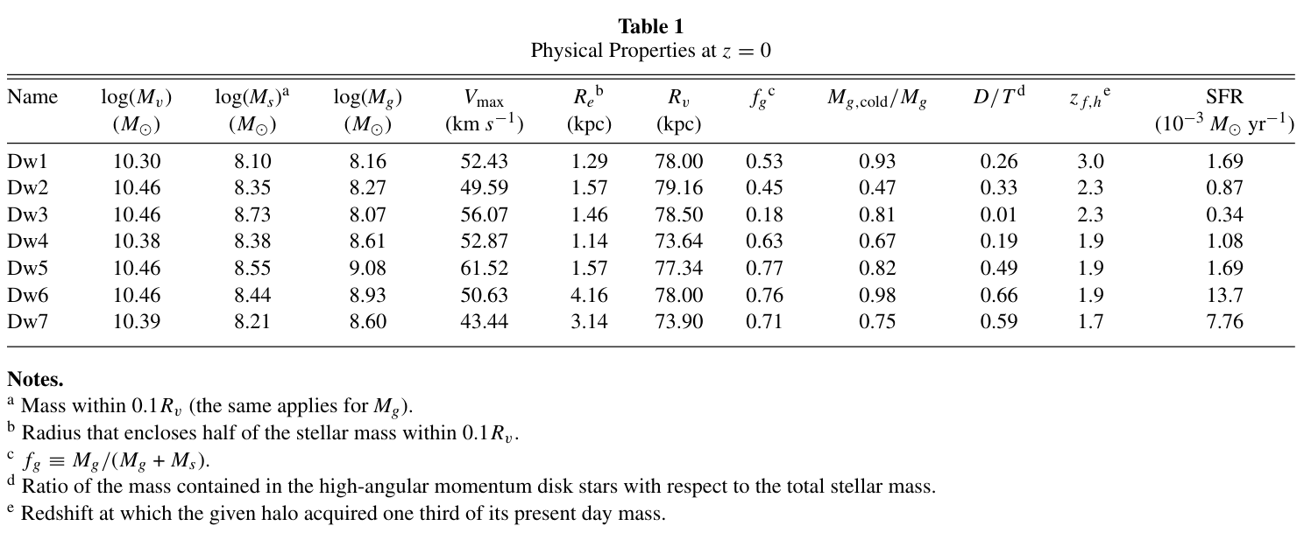
New Parameters
Other n-body simulations investigating dwarf galaxy evolution and star formation ^{3,4}
Still being tested

Slide 12
Summary
test | version | branch | params | components | initial | t_{stable} | final
202404132100 | current (Feb 2024) | master | Sid | plummer+plummer | ✓ | 0.5-1.0 Gy | ✓
202404141050 | v1.80 (May 2021) | master | Sid | plummer+plummer | ✓ | 0.5-1.0 Gy | ✓
202404132220 | current (Feb 2024) | master | Sid | plummer+nfw | ✓ | 0.5-1.0 Gy | ✓
202404141025 | v1.80 (May 2021) | master | Sid | plummer+nfw | ✓ | 0.5-1.0 Gy | ✓
202404021330 | current (Feb 2024) | master | Eric | plummer+plummer | ✓ | 2.5-3.0 Gy | ?
202404082220 | v1.80 (May 2021) | master | Eric | plummer+plummer | ✓ | 2.5-3.0 Gy | ?
202404021450 | current (Feb 2024) | master | Eric | plummer+nfw | ✓ | 2.5-3.0 Gy | ?
202404082325 | v1.80 (May 2021) | master | Eric | plummer+nfw | ✓ | 2.5-3.0 Gy | ?
202404131940 | current (Jan 2024) | sidm | Sid | plummer+sidm | ✓ | 1.5-2.0 Gy | ?
202404072115 | current (Jan 2024) | sidm | Eric | plummer+sidm | ✓ | 3.0-3.5 Gy | ✗
Notes:
T_stable

Slide 13
SIDM profile generator
Still under investigation
Divide by 0 error
Copied over to SIDM?
Compounded instability from Eric’s parameters and faulty SIDM profile generator
Notes:
Previous report: divide by 0 error in nfw profile
- copied over to SIDM?

Slide 14
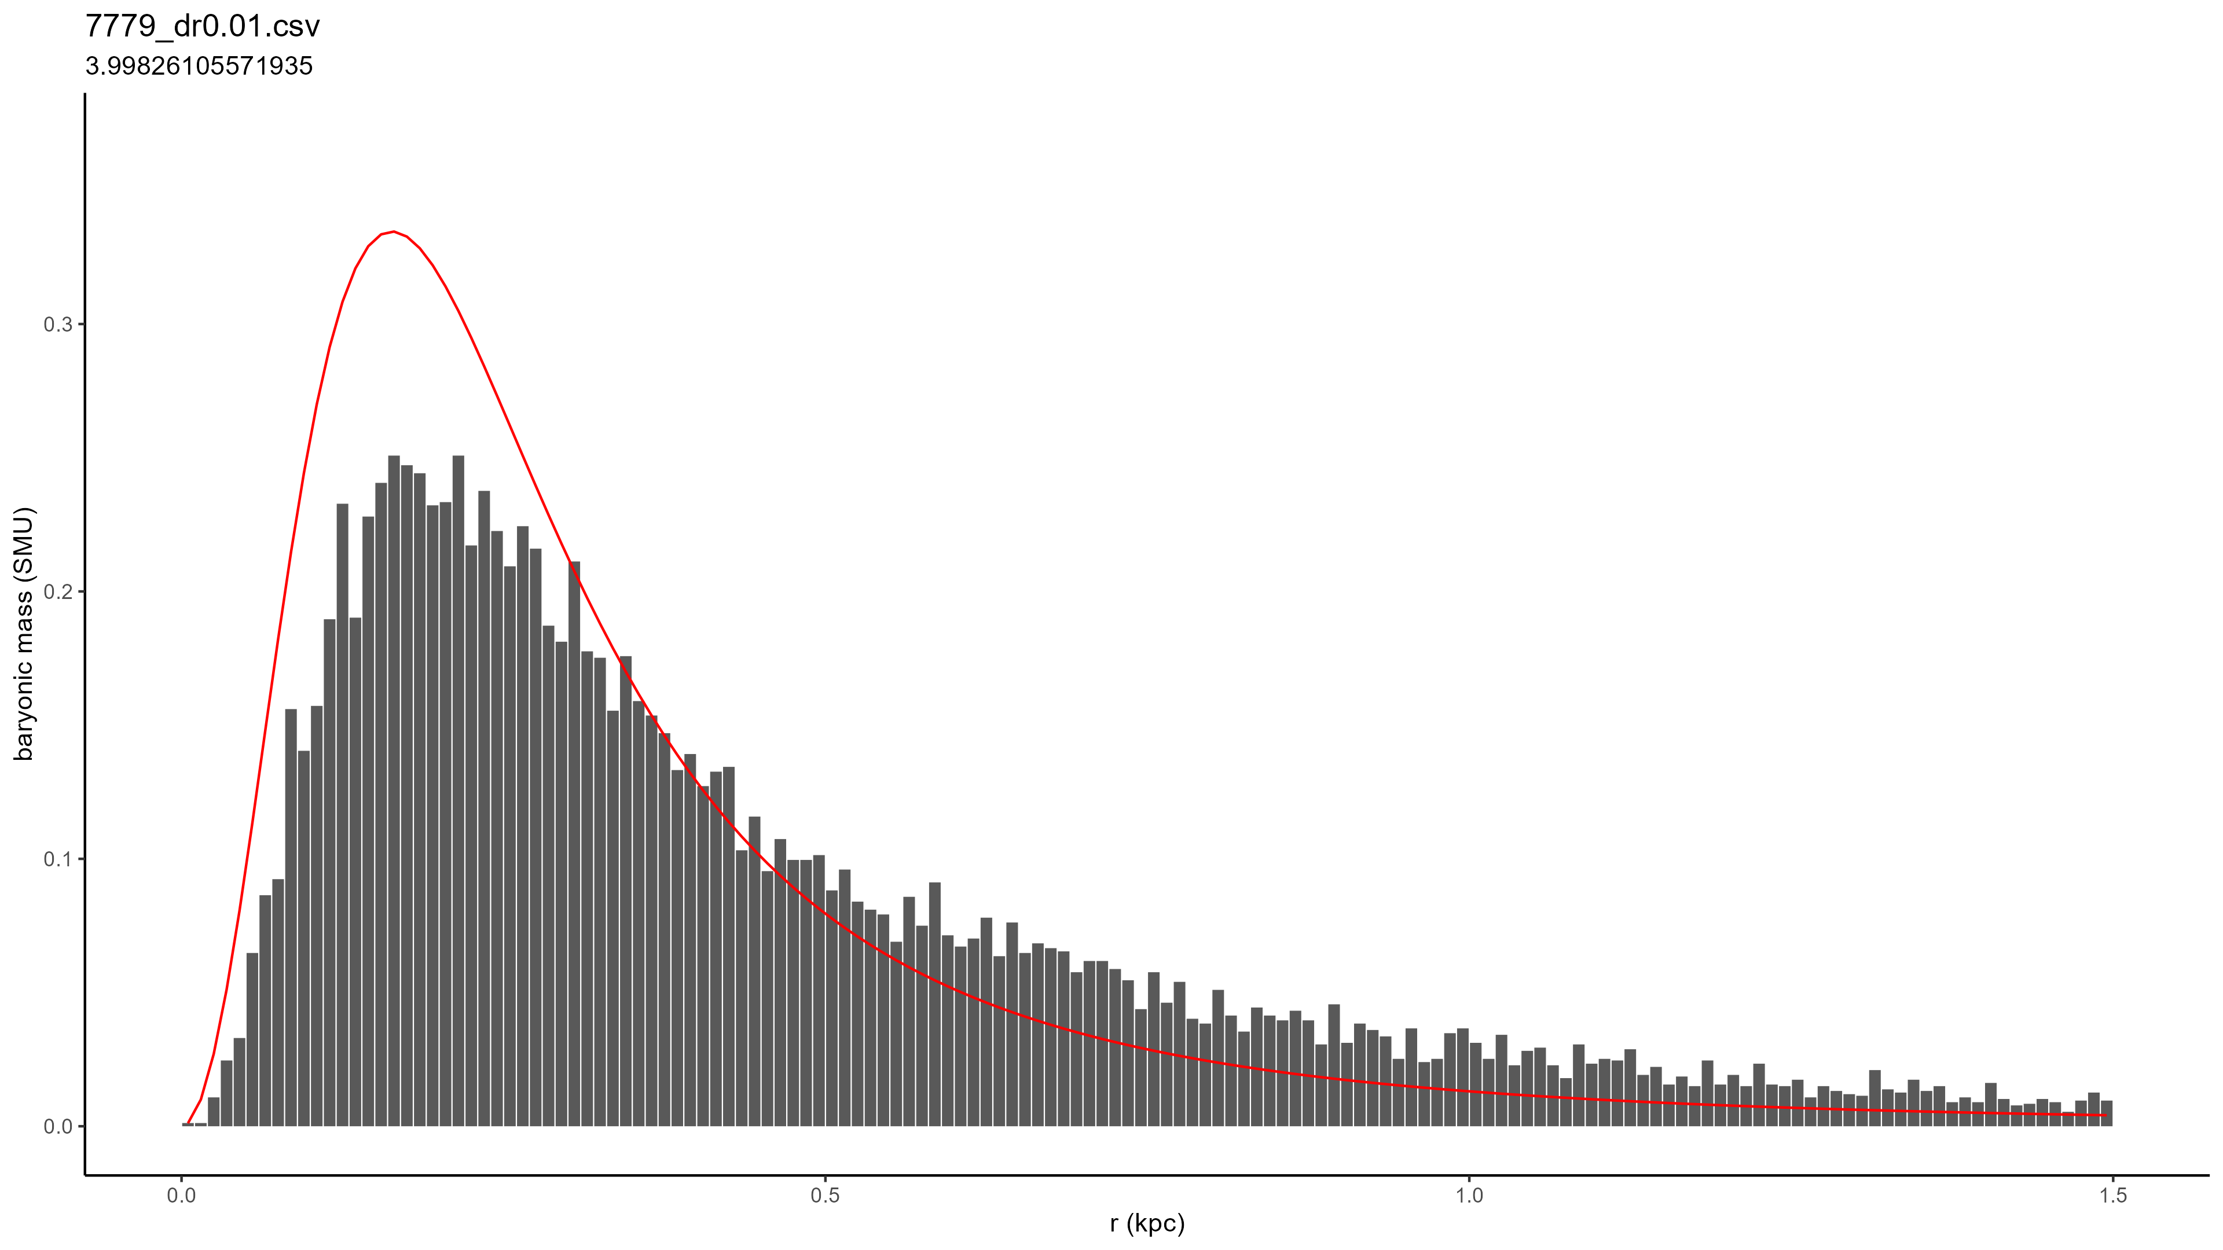
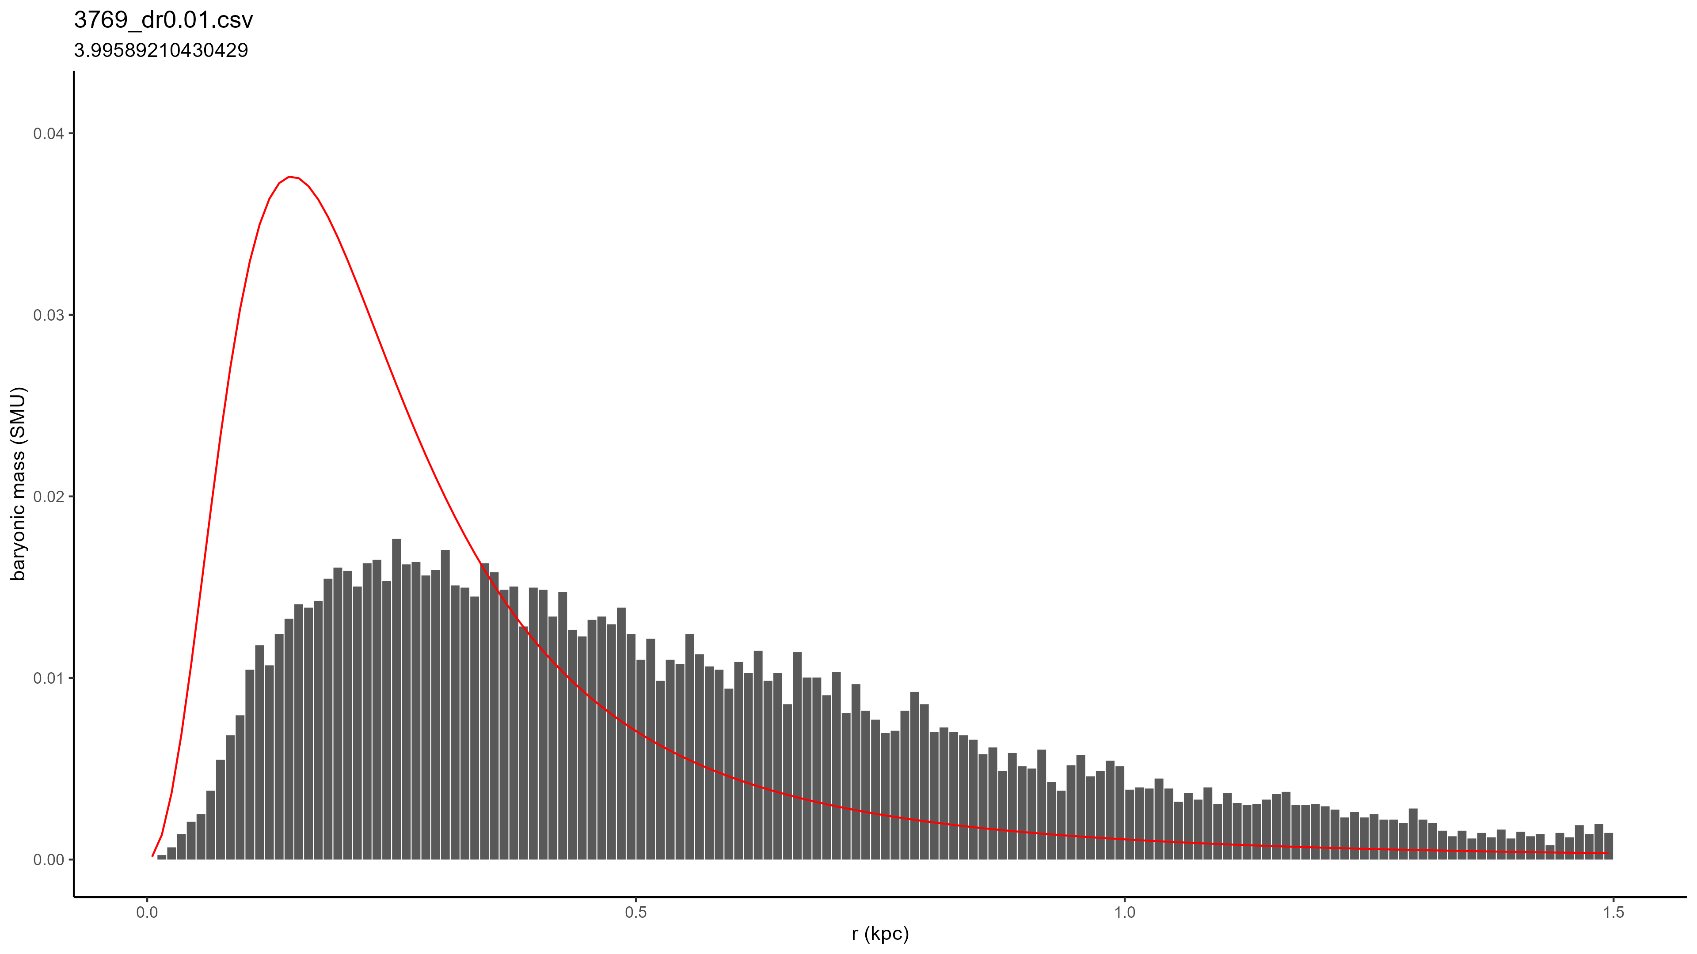
Concluding Remarks
Check your dwarf galaxies in isolation
Make sure the initial and final states are reasonably similar
Also check in between (t_{stable})
Ideally between 0-1 GY

Slide 15
References
¹ S. Shelton, Constraining Dwarf Galaxy Properties Using Tidal Streams, December 2018, https://milkyway.cs.rpi.edu/milkyway/publications/Sid_thesis.pdf
² W. Allen, Predicting Dwarf Stability, August 2020
³ S. Valcke, S. De Rijcke, H. Dejonghe, Simulations of the formation and evolution of isolated dwarf galaxies, Monthly Notices of the Royal Astronomical Society, Volume 389, Issue 3, September 2008, Pages 1111–1126, https://doi.org/10.1111/j.1365-2966.2008.13654.x
⁴ A. González-Samaniego et al 2014 ApJ 785 58 (https://iopscience.iop.org/article/10.1088/0004-637X/785/1/58)

